Slide 1

EXCEL
INDEX & MATCH

Slide 2
INDEX
The INDEX function in Excel is used to return the value of a cell at a specified row and column within a given range.
The syntax is INDEX(array, row_num, [column_num])
array – The range of cells from which to return a value.
row_num – The row number within the array from which to retrieve a value.
column_num (optional) – The column number within the array (if omitted, it defaults to 1).

Slide 3
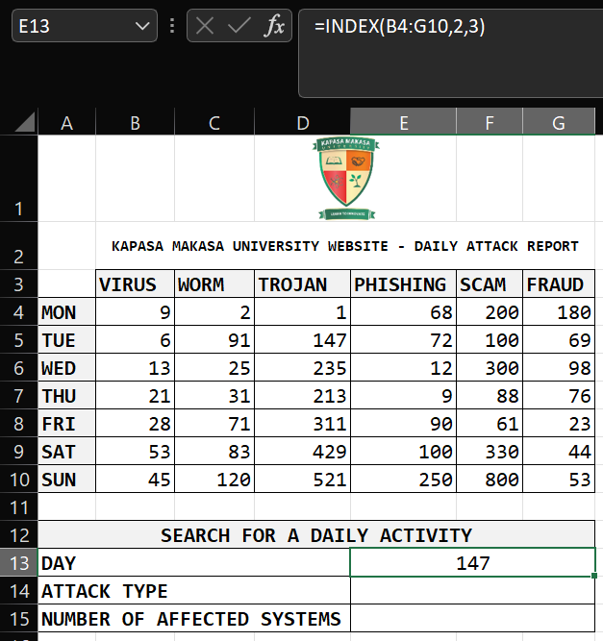
INDEX (Continues…)
Note that our target is 147
Based on our section B4:G10, 147 is in row 2 column 3.

Slide 4
MATCH
The MATCH function in Excel is used to find the position of a value in a row or column.
It returns the relative position of the lookup value, not the actual value itself.
The syntax is MATCH(lookup_value, lookup_array, [match_type])
lookup_value – The value you want to find.
lookup_array – The range of cells where you want to search.
match_type (optional)
1 (default) – Finds the largest value less than or equal to lookup_value (array must be sorted in ascending order).
0 – Finds the exact match.
-1 – Finds the smallest value greater than or equal to lookup_value (array must be sorted in descending order).

Slide 5
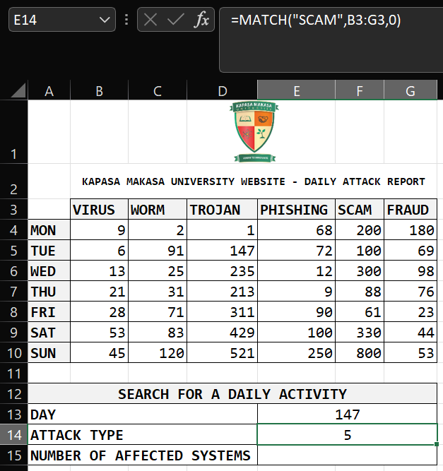
MATCH (Continues…)
Note that our target is SCAM
Based on our section B3:G3, SCAM is on position number 5.

Slide 6
INDEX & MATCH
The INDEX and MATCH functions are often combined to create a more flexible and powerful alternative to VLOOKUP.
The syntax is =INDEX(return_range, MATCH(lookup_value, lookup_column, 0))
It can be used in Fraud Prevention & Detection Technologies to;
Detecting Duplicate Transactions
Identifying Suspicious Customers
Cross-Referencing Blacklisted Accounts
Analyzing Fraudulent Patterns

Slide 7
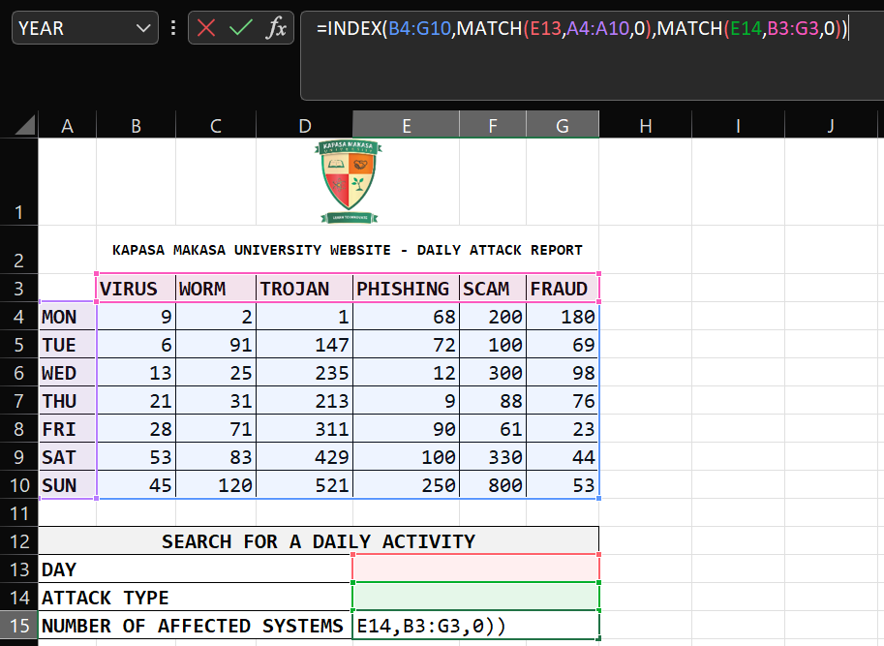
INDEX & MATCH (Continues…)
Our target array is B4:G10
The row number is now MATCH(E13,A4:A10)
E13 is our lookup_value to allow the user to enter the DAY between MON – SUN
A4:A10 is our array to represent the DAY (MON – SUN) we are looking for
The column number is now MATCH(E14,B3:G3)
E14 is our lookup_value to allow the user to enter the ATTACK TYPE
B3:G3 is our array to represent the ATTACK TYPE we are looking for
0 represents the exact match

Slide 8
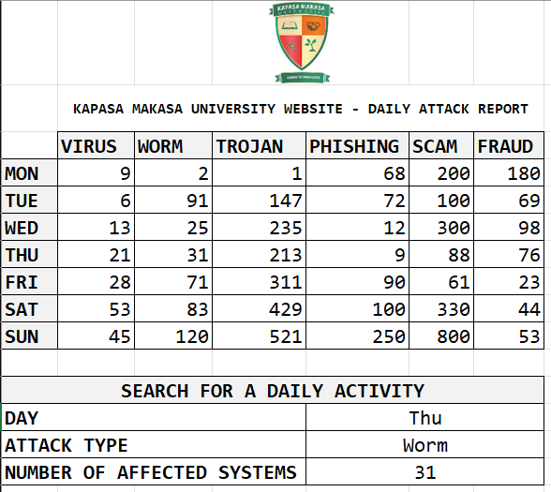
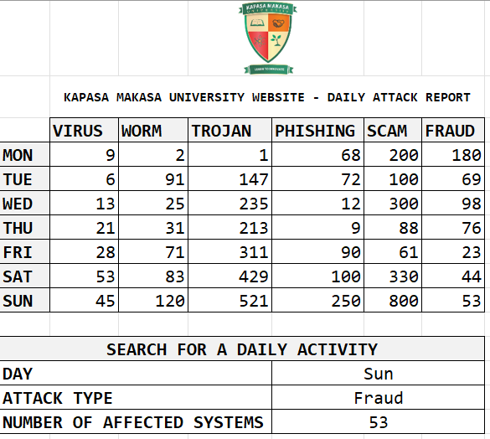
INDEX & MATCH (Continues…)

Slide 9
ICT SOCIETY | EXCEL SLIDES
PREPARED BY JAMES SOKO

